Slide 1
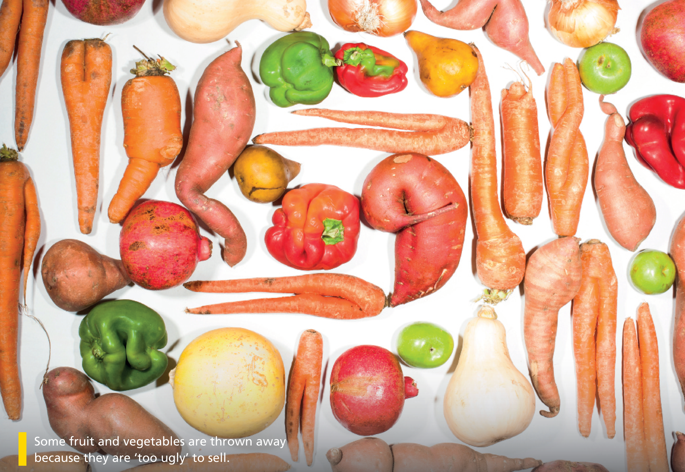

Bringing the world to the classroom and the classroom to life
NGL.CENGAGE.COM/ELT
A PART OF CENGAGE

Slide 2

5e We look forward to your reply
Writing a formal letter/email
1 A group of students has written to the manager of a local supermarket. Read the letter quickly. What is its purpose? Choose the correct option (a–c).
a to ask about prices in the supermarket
b to complain about the supermarket’s actions
c to invite the supermarket to stock new products
5e-p. 65

Slide 3
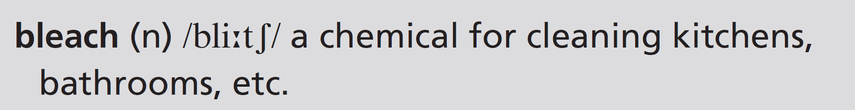
Dear Sir
We are writing to express our shock at the news that your supermarket is throwing out huge amounts of fresh food every day. Not only that, but you put bleach on the food and as a result it becomes inedible.
In our view, this will have serious consequences for people in need. As you may know, many people can’t afford to buy enough food every week. If you stop putting bleach on the food that you throw out, this will mean people can make use of it.
There are several local organizations that could use this unsold food. Will your supermarket consider working with them to pass on unwanted food to people who need it? Most food is still of good quality for some time after its sell-by date and therefore it should not be thrown out.
In addition, a lot of the unsold food that you throw out has reached its sell-by date. If your supermarket reduces the price of this food (as some of your competitors do), more people will be able to buy it. This will lead to less waste and more profit for you.
We look forward to your reply.
Yours faithfully
Year 11
Broadchurch High School
5e-p. 65

Slide 4
2 Read the letter again. Answer the questions about each paragraph.
Paragraph 1
Paragraph 2
Paragraph 3
Paragraph 4
What two actions are the students writing about?
Who is affected by the supermarket’s actions?
What question do the writers have?
What alternatives do the writers suggest?
1 the supermarket is throwing out huge amounts of fresh food every day; it is also putting bleach on food
2 people who need the food
3 Will your supermarket consider working with them [local organizations] to pass on unwanted food to people who need it?
4 passing food on to local organizations, reducing the price of food when it reaches its sell-by-date
5e-p. 65

Slide 5
3 Writing skill explaining consequences
a Find these words in the letter. They link causes and consequences. For each word, underline the cause and circle the consequence.
1 as a result (paragraph 1)
2 mean (paragraph 2)
3 lead to (paragraph 4)
1 cause: you put bleach on the food
consequence: it becomes inedible
2 cause: If you stop putting bleach on the food that you throw out
consequence: people can make use of it
3 cause: more people (will be able to) buy it [the food]
consequence: less waste and more profit for you.
5e-p. 65

Slide 6
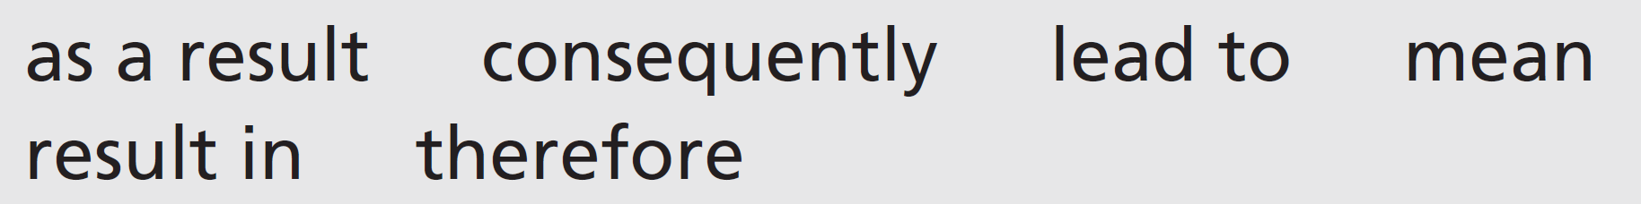
b Complete the sentences with these words. Sometimes, more than one option is possible.
1 We object strongly to this plan. __________________________________, we will not be able to support it.
2 We welcome the new community kitchen. This will ______________________________ more people eating a hot meal.
3 The prices have gone up. _______________________________________, fewer people will shop here.
4 New price policies _____________________ we’ll be able to buy more.
5 We suggest lowering prices as this could ___________________________ more customers coming in.
6 We reduced our prices and ______________________________________ increased the number of customers.
As a result / Consequently / Therefore
lead to / mean / result in
As a result / Consequently / Therefore
mean
mean / lead to / result in
as a result / consequently / therefore
5e-p. 65

Slide 7
4 Prepare a letter with your reaction to one of these situations. Make notes before you start. Use the questions in Exercise 2 to guide you.
• Your college is going to close the student cafeteria.
• Your favourite TV show is being scrapped.
• Your employer/school has banned junk food and drink machines.
• Your local swimming pool is being closed.
5 Write your letter. Follow the structure of the paragraphs in Exercise 2. Use these questions to check your letter.
• Is the style correct for a formal letter?
• Is the purpose of the letter clear?
• Is it clear what action the person who the letter is addressed to needs to take?
6 Exchange letters with your partner. Read your partner’s letter. Take the role of the person it is addressed to. Are you going to take any action as a result of the letter? Write a short reply to the letter.
5e-p. 65

Slide 8
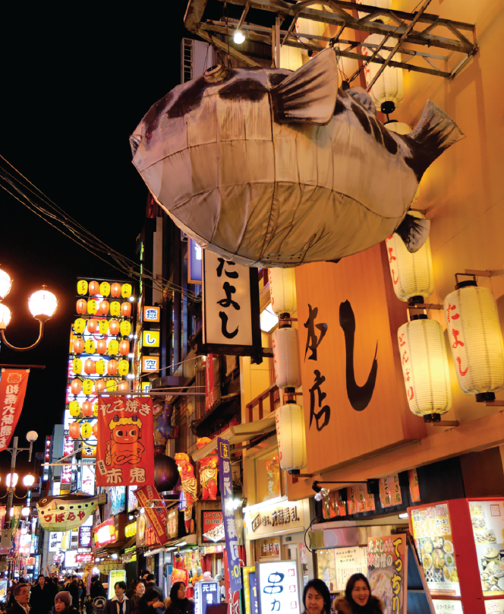
5f Dangerous dining
Before you watch
1 Look at the photo and write six words connected to it. Then work in pairs. Compare your list with your partner.
EXAMPLE ANSWERS
A possible list: fugu, fish, dangerous, Japan, Japanese, restaurant, neon, night, lights, dark
A fugu restaurant in Osaka, Japan
5f-p. 67

Slide 9
2 Key vocabulary
a Read the sentences. The words in bold are used in the video. Guess the meaning of the words.
1 Sugar is a major cause of people’s problems with their teeth.
2 Some snakes have poison in their teeth.
3 Check the regulations before you enter the competition.
4 Lots of people go to the dentist annually.
5 If you feel nervous, breathe in and out slowly.
b Match the words in bold in Exercise 2a with these definitions.
2
4
5
3
1
a something that can kill you if you eat or drink it
b every year
c take air into your lungs
d official rules
e important, big
5f-p. 67

Slide 10

While you watch
3 Watch the first part of the video (0.00– 0.42) with the sound OFF. Discuss the questions.
1 Which country are the people in?
2 What kind of food can you see?
3 What do you think could be dangerous about this food?
4 Watch the first part of the video again with the sound ON. Check your ideas from Exercise 1 and find out the name of the food.
1 Japan
2 puffer fish, or fugu
3 It’s poisonous unless properly prepared.
5 Watch the second part of the video (0.43–1.43) with the sound OFF. What do you think the diners (Tom and Aki) and the chef are saying to each other? Then watch with the sound ON and check your ideas.
Students’ own answers
5f-p. 67

Slide 11
6 Watch the whole video. Choose the correct option to complete the sentences.
1 A lot of people died from eating fugu after / during World War II.
2 At this time, licences for catching and selling / preparing and serving fugu were introduced.
3 There were 2,500 / 10,500 deaths from fugu from 1945 to 1975.
4 Nowadays only about three people die every year, mostly from poisoning at home / in restaurants.
5 One tiger fugu has enough toxin to kill 3 / 30 people.
6 The fugu toxin attacks a person’s heart / lungs.
5f-p.67

Slide 12
Videoscript
Dangerous dining
Part 1
0.00–0.39 Fish is a major food in Japan. Every morning, thousands of fish sellers crowd the famous Tsukiji seafood market in Tokyo. Here, no product has a higher price than the one that’s the most dangerous – the puffer fish, or fugu.
Eating this fish is like playing a dangerous game. If a person gets a piece that has poison in it, he or she may die! Despite the danger, fugu appears on more than 80 menus in the Asakusa restaurant area of Tokyo. The puffer is so ugly, it’s cute, but it doesn’t fool most diners.
Part 2
0.40–1.06 Tom Caradonna has come to Tokyo for the complete fugu experience, and he’s brought his friend, Aki. Wisely, Tom has chosen to eat at the famous Matsumoto restaurant. This fugu restaurant is 120 years old and it’s well-known for its careful preparation of puffer fish. That’s important when you’re taking risks with a toxin that is 1,000 times stronger than cyanide!
1.08–1.13 ‘I’ve heard stories about people dying by trying the fugu, but it hasn’t really concerned me.’
1.14–1.26 Even though Tom isn’t too worried to try fugu, there is a big risk. Over the years, hundreds of people have died from eating it. Chef Hayashi is the one who must prepare the fish safely so that Tom and Aki don’t get sick.
1.27–1.43 ‘It’ll be fine, don’t worry. I’ve been doing this for 53 years. I took the exam in 1949 and passed. This is my fugu chef licence.’

Slide 13
Videoscript
Dangerous dining
Part 3
1.44–2.26 After World War II, there were many deaths from eating fugu. Many Japanese people were very hungry, and some looked for food in restaurant rubbish. Sometimes they found fugu which had been thrown out. When they cooked and ate the fish, they got sick or died. Eventually, General Douglas MacArthur, who led the US forces in Japan, created strict controls and regulations. Fugu chefs had to get licences for preparing and serving puffer fish. Even with more regulations, fugu killed 2,500 Japanese people between 1945 and 1975. Regulations and education have cut the number of deaths to only three annually, but many diners still get sick.
2.27–2.37 ‘ About 70 per cent of the poisonings happen in private homes where people catch and prepare fugu on their own and get poisoned. That’s most common.’

Slide 14

After you watch
7 Vocabulary in context
a Watch the clips from the video. Choose the correct meaning of the words and phrases.
b Complete the sentences in your own words. Then work in pairs and compare your sentences.
1 I saw an advert for a holiday with a complete … experience.
2 One thing that concerns me is … .
3 The last time I got sick was … .
4 Have you ever fooled anyone?
5 Do people in your country eat mainly in restaurants or in private homes?
5 Students' own answers
EXAMPLE ANSWERS
1 I saw an advert for a holiday with a complete festival/ travel/adventure experience.
2 One thing that concerns me is next month’s exam/the weather.
3 The last time I got sick was when I was very young/when I was on holiday.
4 Yes, once when I performed a magic trick on a friend.
5f-p. 67

Slide 15
Videoscript
Dangerous dining
c
b
c
a
a
1 The puffer is so ugly it’s cute, but it doesn’t fool most diners.
a appeal to
b frighten
c trick
2 Tom Caradonna has come to Tokyo for the complete fugu experience.
a to catch fugu with local fishermen
b to eat all types of fugu dishes
c to report on deaths from fugu
3 ... but it hasn’t really concerned me.
a helped
b included
c worried
4 Chef Hayashi is the one who must prepare the fish safely so that Tom and Aki don’t get sick.
a become ill
b die
c enjoy the meal
5 About 70 per cent of the poisonings happen in private homes ...
a people’s houses
b secret places
c small restaurants

Slide 16
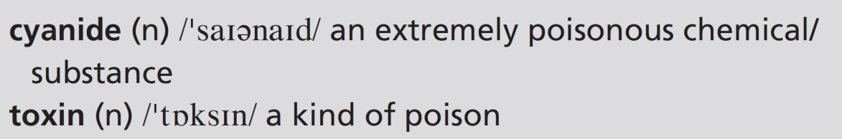
8 What, in your opinion, is the best ending (a–c) for this sentence? Compare with your partner.
The best way to avoid getting sick from fugu is:
a by going to a well-known restaurant.
b not to eat it.
c to take anti-toxin medicine.
Students’ own ideas
9 Work in pairs to prepare a survey on risk-taking. Look at the sentence in Exercise 8 and write three similar sentences for activities that include risks. Then ask your classmates their opinions. Which are the most popular responses?
5f-p. 67

Slide 17
UNIT 5 REVIEW AND MEMORY BOOSTER
Grammar
1 Read the conversation between two friends who are cooking. Cross out any incorrect options.
A: Do you know how to make risotto?
B: Oh yes. 1 I show / I’ll show you if you want.
A: OK, great. 2 Can / Must I use this pan?
B: Yes, sure. You 3 have to / don’t have to ask.
A: When the onion 4 is / will be ready, I add the rice.
B: Yes, then the liquid. But you 5 must / have to add it slowly. Don’t add more until the rice 6 absorbs / will absorb it.
A: OK, that’s all the liquid in. 7 Am I allowed to / Should I stir it all the time now?
U5 Review-p. 68

Slide 18
B: Yes, because you 8 must / mustn’t let it stick to the pan. If it 9 sticks / will stick, it will burn.
A: 10 Should I / Do I have to add salt?
B: You can if you want to, but you 11 mustn’t / don’t have to. And the risotto 12 can’t / has to rest for a while before 13 you eat / you’ll eat it.
A: 14 Am I allowed to / Do I have to taste it?
B: Of course you are. You made it!
2 Answer the questions about the conversation in Exercise 1.
1 Are the friends making a hot or a cold dish?
2 Why is it important to add the liquid slowly?
3 Why is it important to stir all the time?
1 hot
2 If you don’t add the liquid slowly, the rice won’t absorb the liquid.
3 If you don’t stir it all the time, it will stick to the pan.
U5 Review-p. 68

Slide 19

3 Work in pairs. Think of other modal verbs you can use in Exercise 1 items 2, 5, 7, 8, 10, 12 and 14. How does the meaning of the sentences change?
2 Do I have to: Is there another pan I can use? Should: Is it a good idea to use this pan?
5 should: it’s recommended
7 Can: I’d like to stir it all the time – is it OK if I do? Do I have to: Is it really important to stir it all the time?
8 shouldn’t: it isn’t recommended can’t: It’s a bad idea. If you do there will be a problem.
10 Can: I like salt, so is it OK if I add some? Must: Is salt absolutely necessary?
12 should: It’s recommended; it’s a good thing to let the risotto rest. must: It’s really important; the risotto won’t be good if it doesn’t rest.
14 Can: I’d like to taste the risotto – is it OK if I do? Must: I don’t really want to taste the risotto.
U5 Review-p. 68

Slide 20
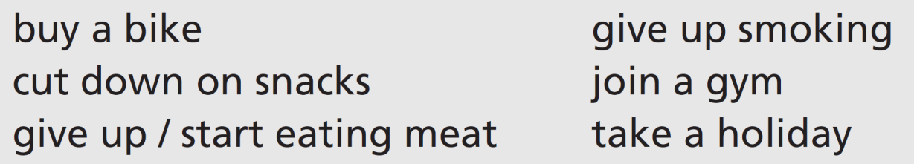
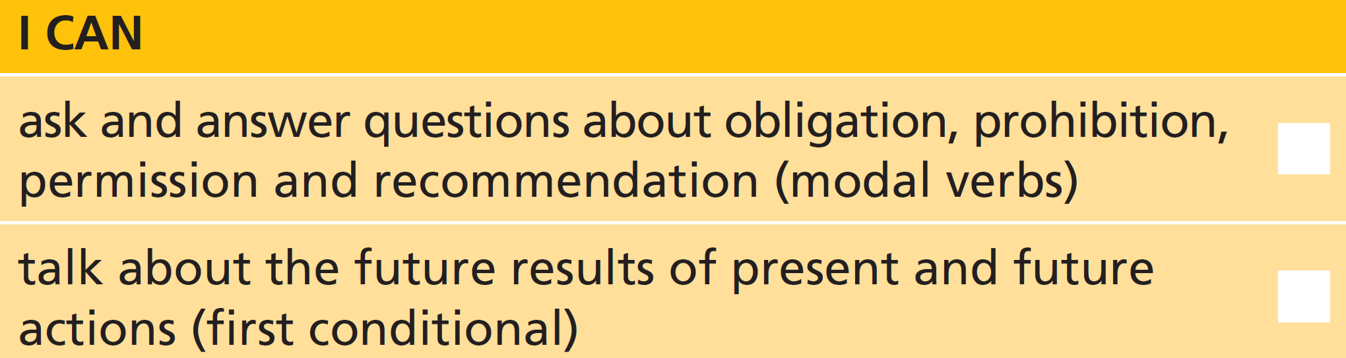
4 Work with a new partner. Take turns to state an intention and start a ‘chain’.
A: I think I’ll buy a bike.
B: If you buy a bike, you’ll get more exercise.
A: Yes. And if I get more exercise, …
U5 Review-p. 68

Slide 21
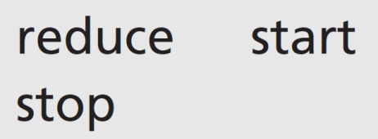
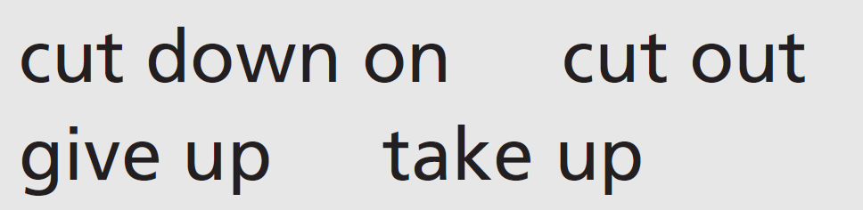
Vocabulary
5 Match the verbs about change with phrasal verbs that mean the same. One of the verbs matches two phrasal verbs. Then write four sentences describing a change that leads to a healthy lifestyle.
reduce = cut down on
start = take up
stop = give up / cut out
Possible sentences:
Cutting down on sugar in your diet can help you lose weight and also helps to avoid problems with your teeth. If you want to get fit, you should take up a new form of exercise. Most people agree that giving up smoking is a good idea. When I wanted to lose weight and look after my heart I cut out very fatty foods from my diet.
U5 Review-p. 68

Slide 22
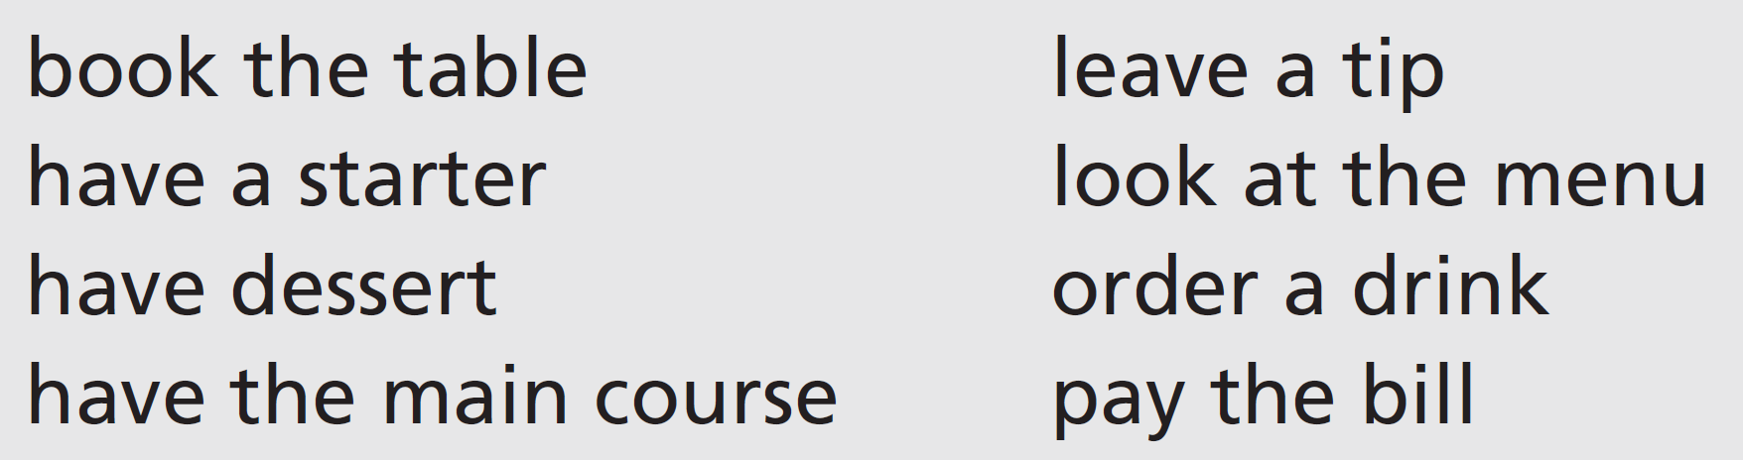
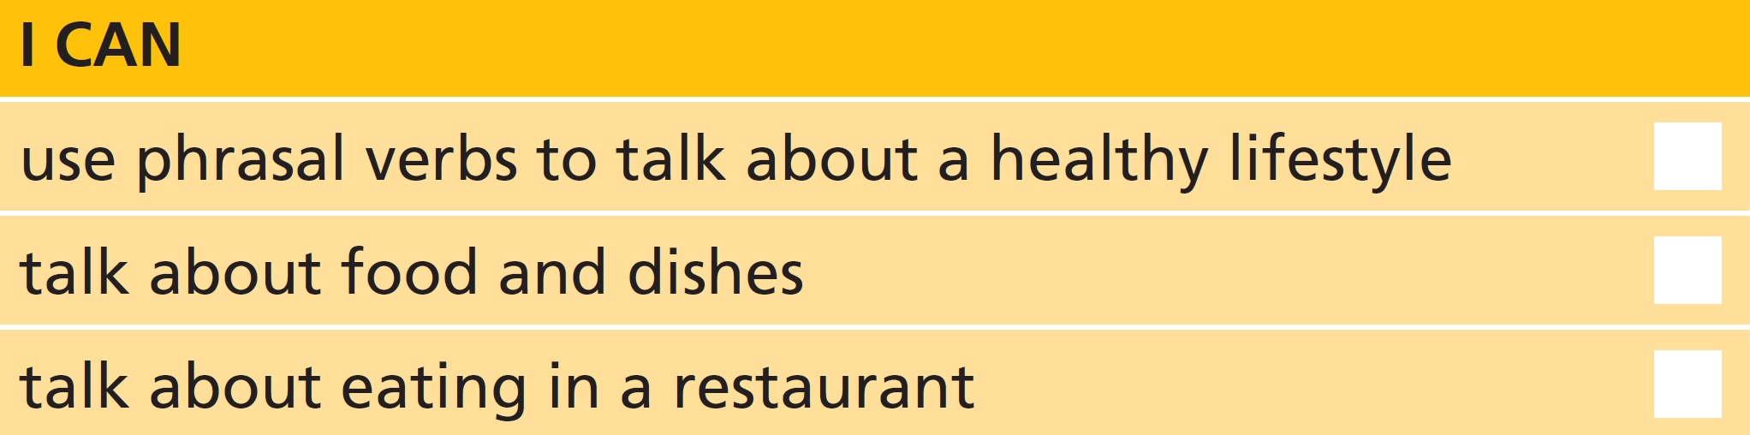
6 Find four things you can eat in Unit 5. Think of two ways to describe each one. Then work in pairs. Try and guess your partner’s things.
7 Work in pairs. Tell your partner if you never, always or sometimes do these things when you eat out. Explain your reasons.
EXAMPLE ANSWERS
I sometimes book the table when we eat out in a restaurant, but usually my husband does it.
I never have a starter – I don’t want to eat too much so I save myself for the dessert instead!
I usually leave a tip, because I think it’s important to show your appreciation of the service in a restaurant.
I always pay the bill by credit card. It’s easier that way and it means I have a record of how much I paid.
U5 Review-p. 68

Slide 23
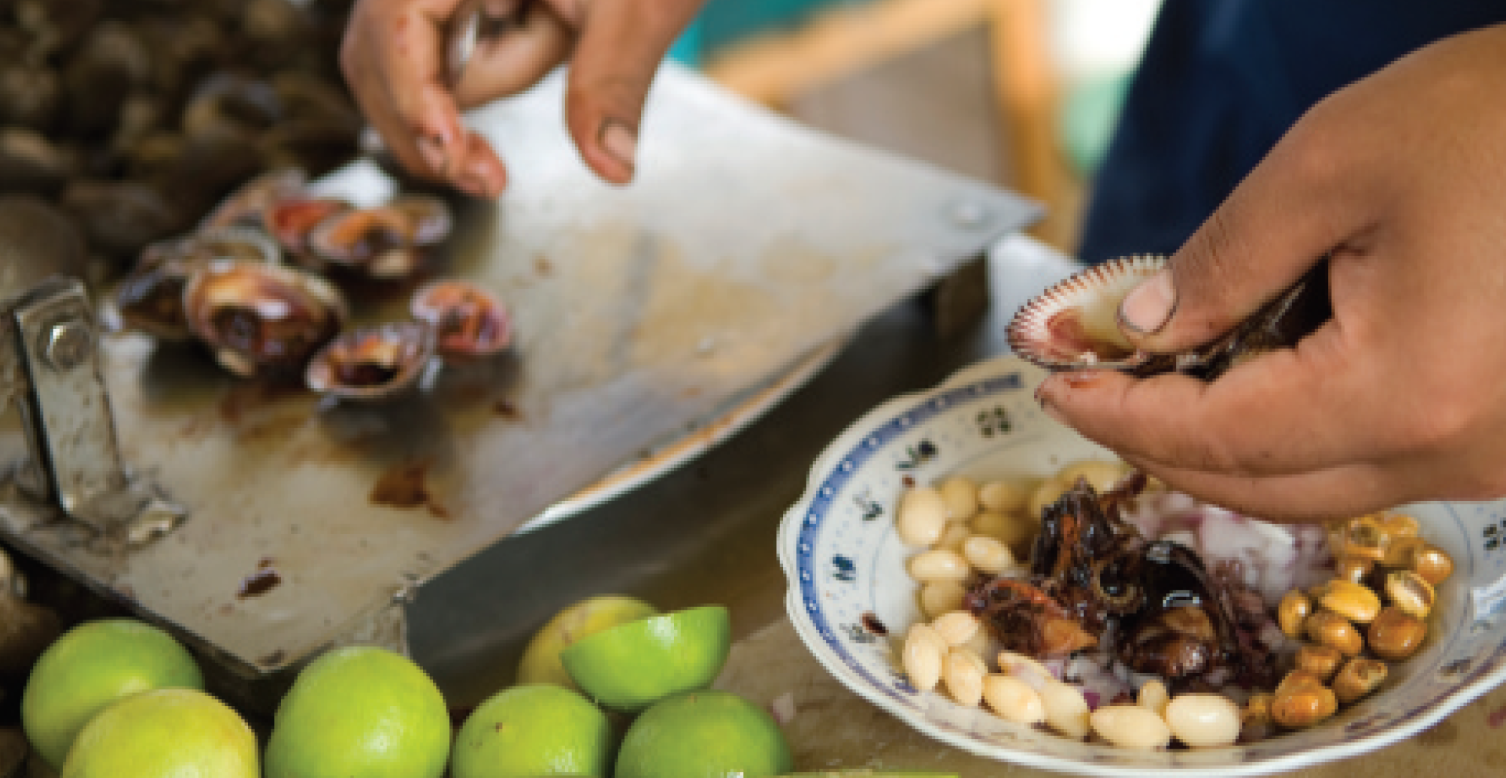
Real life
8 Complete the description of a seafood dish with these words. There is one extra word.
Ceviche is a Latin American dish. It’s a 1 ____________ of seafood dish. It’s 2 ____________ by using the juice of citrus 3 ____________, in this case limes, to ‘cook’ a mix of 4 ____________ fish and seafood.
kind/sort
made
fruit
raw
U5 Review-p. 68

Slide 24
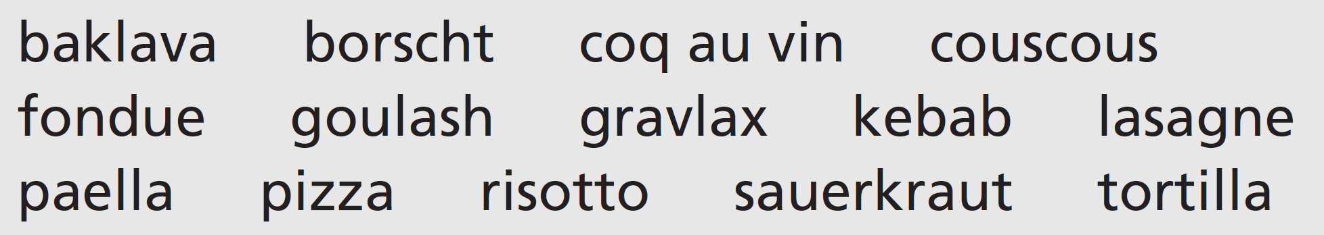

9 Work in groups. Prepare descriptions of as many dishes from the list as you can. Then compare your descriptions with other groups. Are there any dishes nobody is familiar with? Look at page 155 to find out what they are.
U5 Review-p. 68

Slide 25
Communication activities
UNIT 5 Review Exercise 9, page 58
Baklava
A rich, sweet pastry with chopped nuts and syrup or honey. From Turkey, the Caucasus and central Asia.
Borscht
A soup popular in many Eastern and Central European countries. Main ingredient: beetroot.
Coq au vin
A French chicken stew cooked with wine, mushrooms, herbs and garlic.
Couscous
From North Africa. A dish of semolina served with a meat or vegetable stew.
Fondue
Popular in Switzerland and France originally. Pieces of bread are dipped into a dish of melted cheese.
Goulash
A Hungarian meat soup or stew, flavoured with paprika.
Gravlax
Raw salmon cured in salt, sugar and the herb dill. From Scandinavia.
p. 155

Slide 26
Communication activities
UNIT 5 Review Exercise 9, page 58
Kebab
Cubes of meat (or fish) on a skewer, cooked over an open fire. Originally from Central and Western Asia.
Lasagne
An Italian dish of pasta sheets layered with cheese, meat and tomato sauce and baked in the oven.
Paella
A rice dish originally from Valencia, Spain. Rice is cooked in a shallow dish with meat or seafood. Saffron flavours and colours the rice.
Sauerkraut
From northern Europe. Shredded cabbage is fermented until it has a sour flavour.
Tortilla
1 A type of flatbread made from corn or wheat in Central America.
2 A potato omelette from Spain.
p. 155

